Slide 1
Design and Analysis of Algorithms
Recurrences

Slide 2
Recurrences
The expression: is a recurrence.
Recurrence: an equation that describes a function in terms of its value on smaller functions

Slide 3
Recurrence Examples

Slide 4
Methods to solve recurrence
Iteration method
Recursion tree method
Master Theorem

Slide 5
Solving Recurrences
Another option is “iteration method”
Expand the recurrence
Work some algebra to express as a summation
Evaluate the summation
We will show several examples

Slide 6
s(n) =
c + s(n-1)
c + c + s(n-2)
2c + s(n-2)
2c + c + s(n-3)
3c + s(n-3)
…
kc + s(n-k) = ck + s(n-k)

Slide 7
So far for n >= k we have
s(n) = ck + s(n-k)
What if k = n?
s(n) = cn + s(0) = cn

Slide 8
So far for n >= k we have
s(n) = ck + s(n-k)
What if k = n?
s(n) = cn + s(0) = cn
So
Thus in general
s(n) = cn

Slide 9
s(n)
= n + s(n-1)
= n + n-1 + s(n-2)
= n + n-1 + n-2 + s(n-3)
= n + n-1 + n-2 + n-3 + s(n-4)
= …
= n + n-1 + n-2 + n-3 + … + n-(k-1) + s(n-k)

Slide 10
s(n)
= n + s(n-1)
= n + n-1 + s(n-2)
= n + n-1 + n-2 + s(n-3)
= n + n-1 + n-2 + n-3 + s(n-4)
= …
= n + n-1 + n-2 + n-3 + … + n-(k-1) + s(n-k)
=

Slide 11
So far for n >= k we have

Slide 12
So far for n >= k we have
What if k = n?

Slide 13
So far for n >= k we have
What if k = n?

Slide 14
So far for n >= k we have
What if k = n?
Thus in general

Slide 15
Methods to solve recurrence
Iteration method
Recursion tree method
Master Theorem

Slide 16
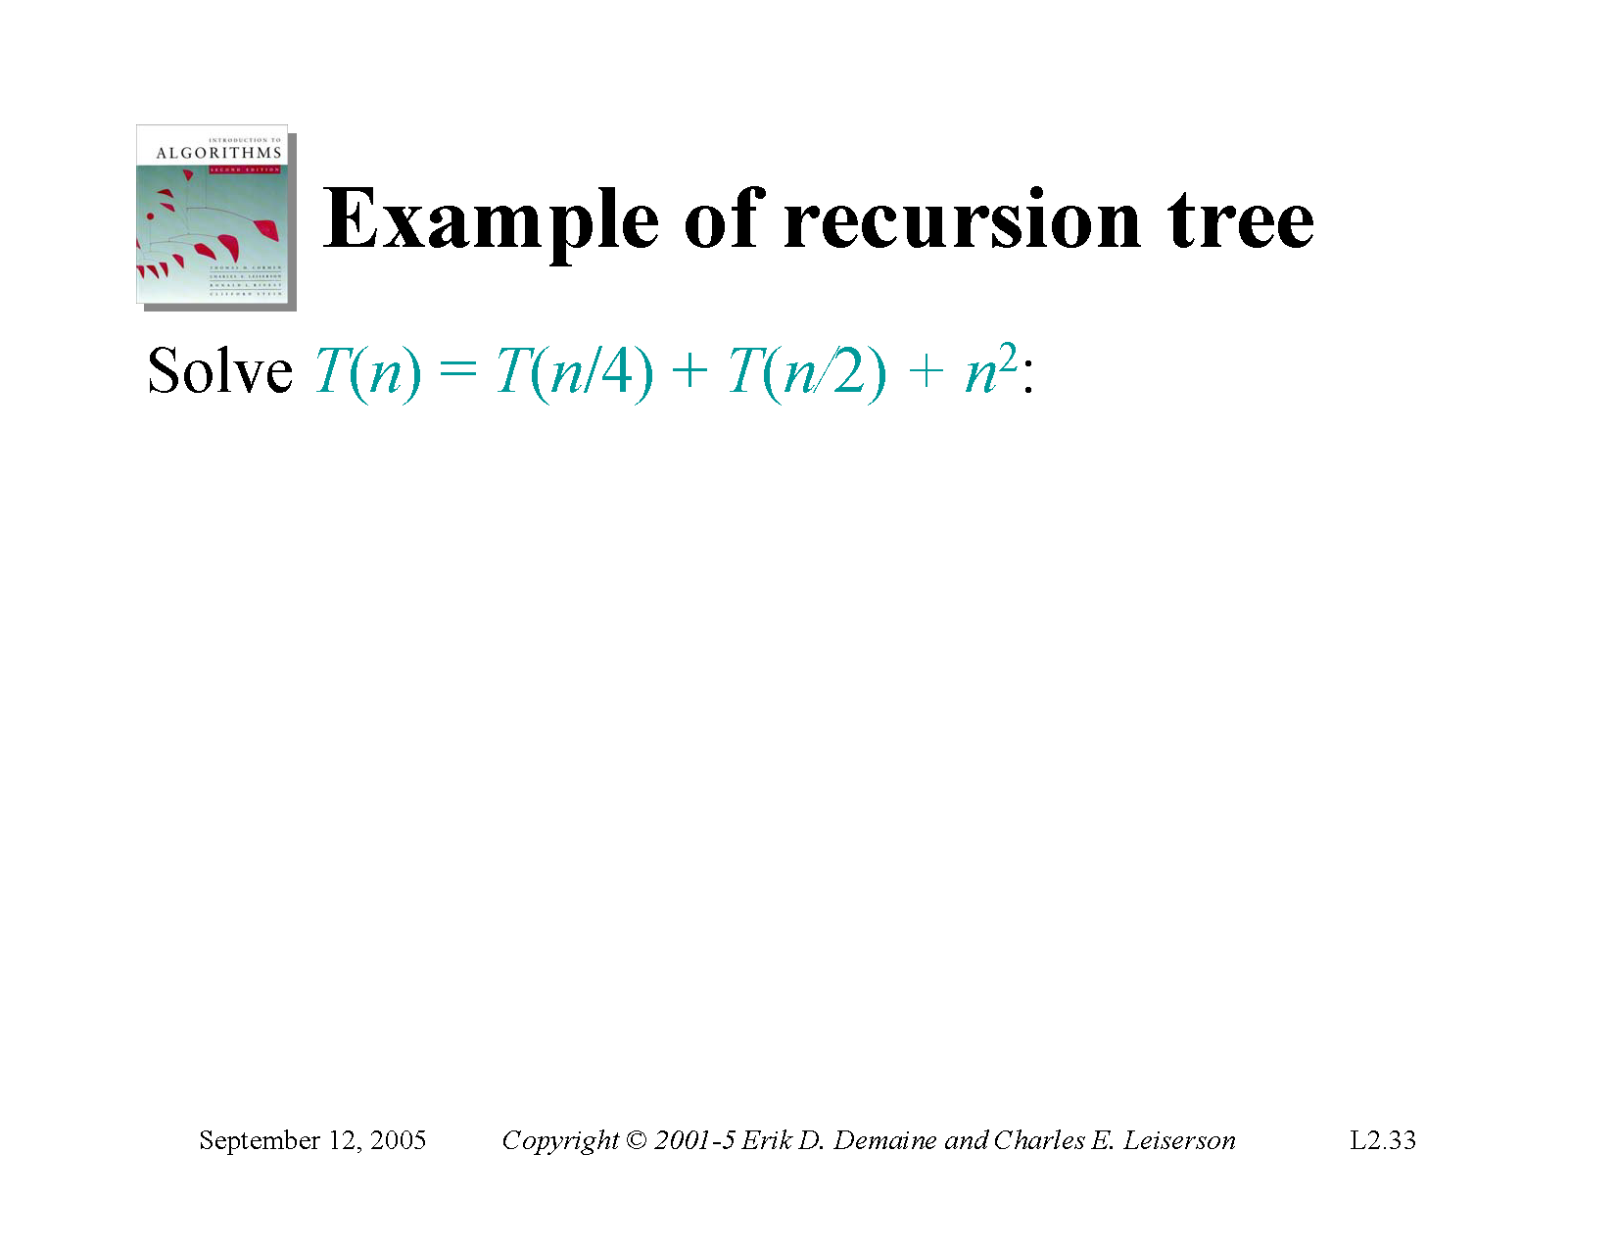

Slide 17
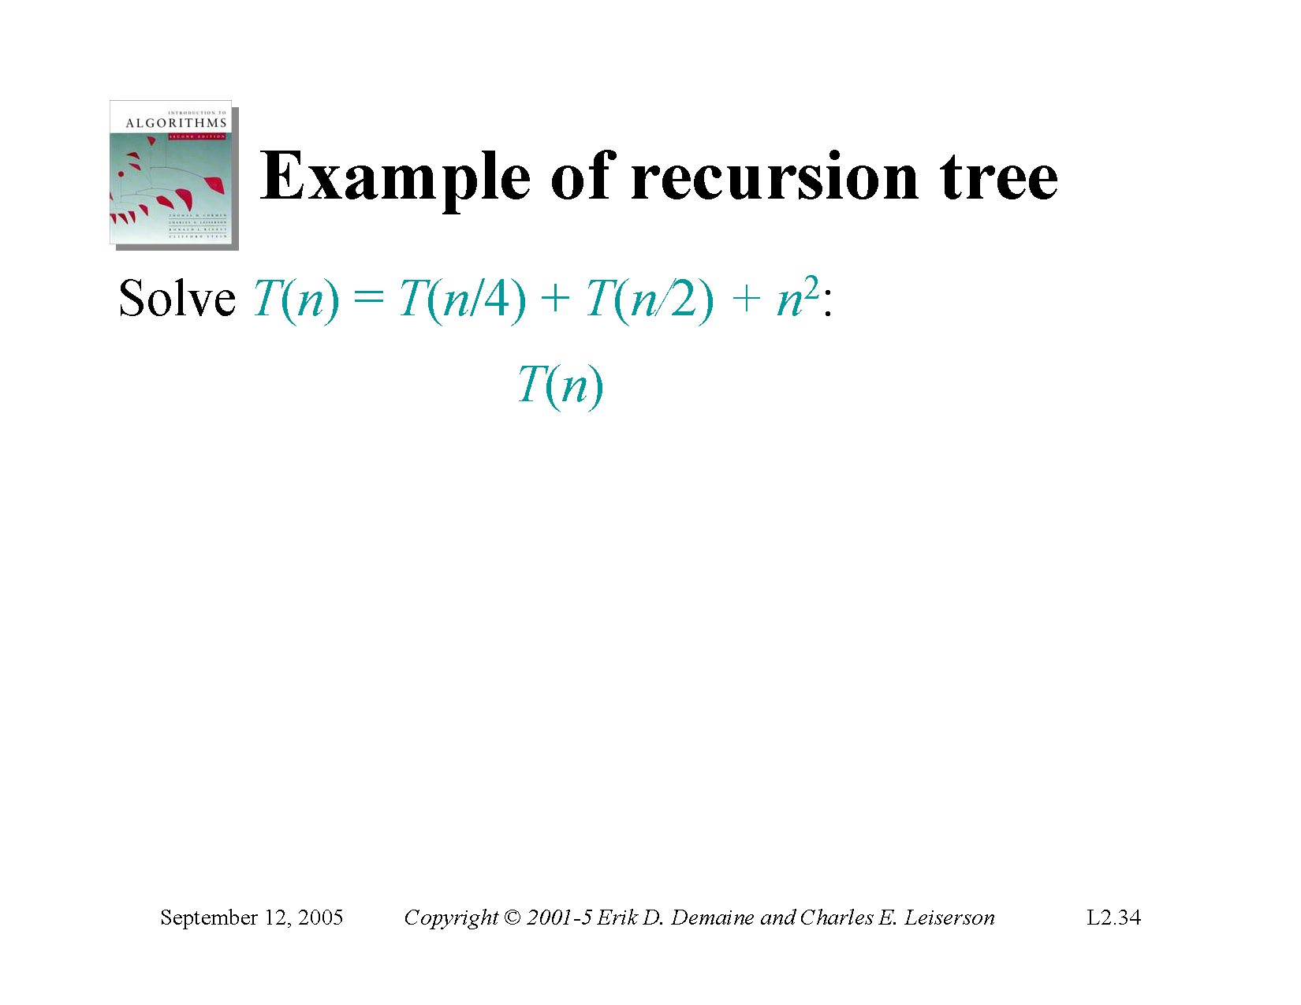

Slide 18
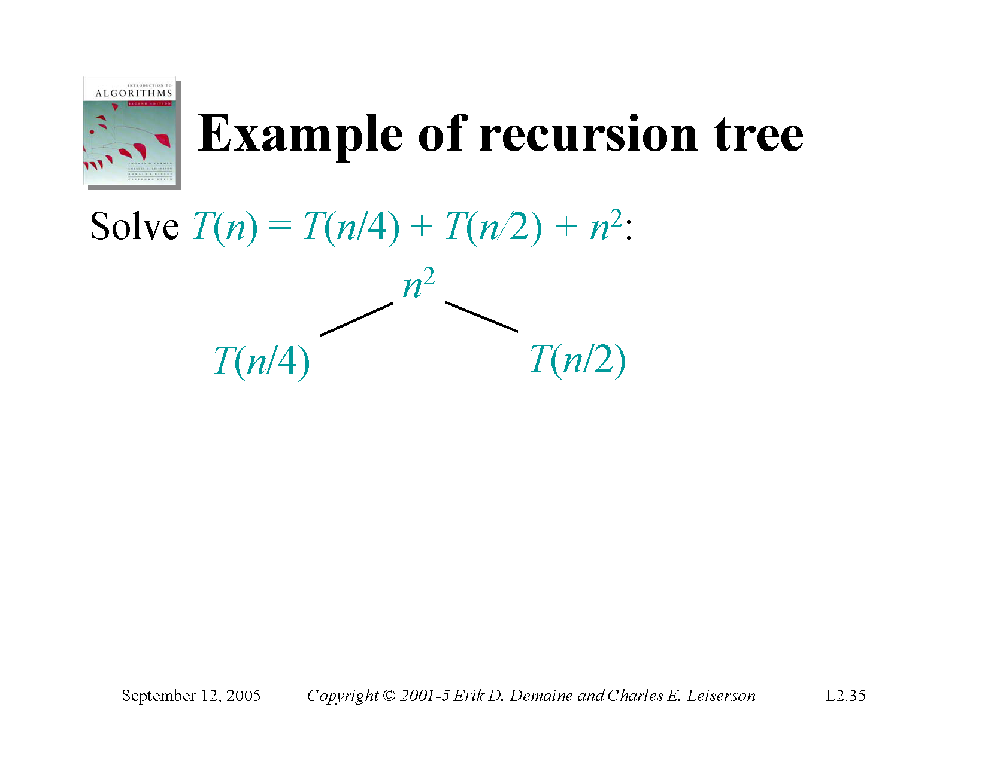

Slide 19
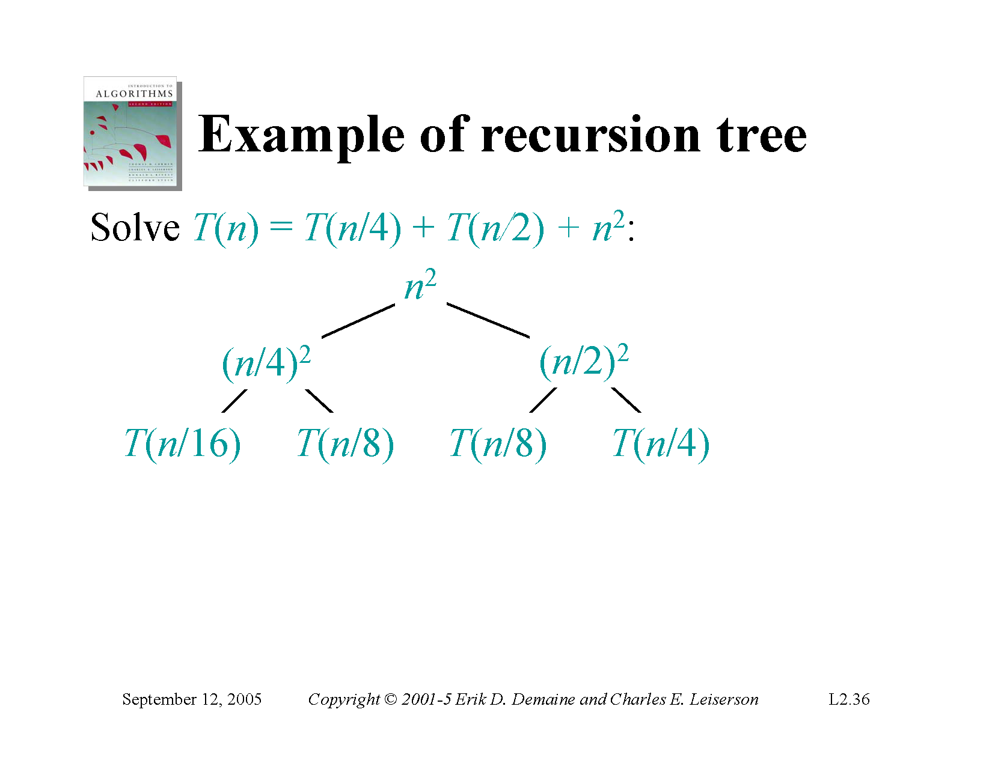

Slide 20
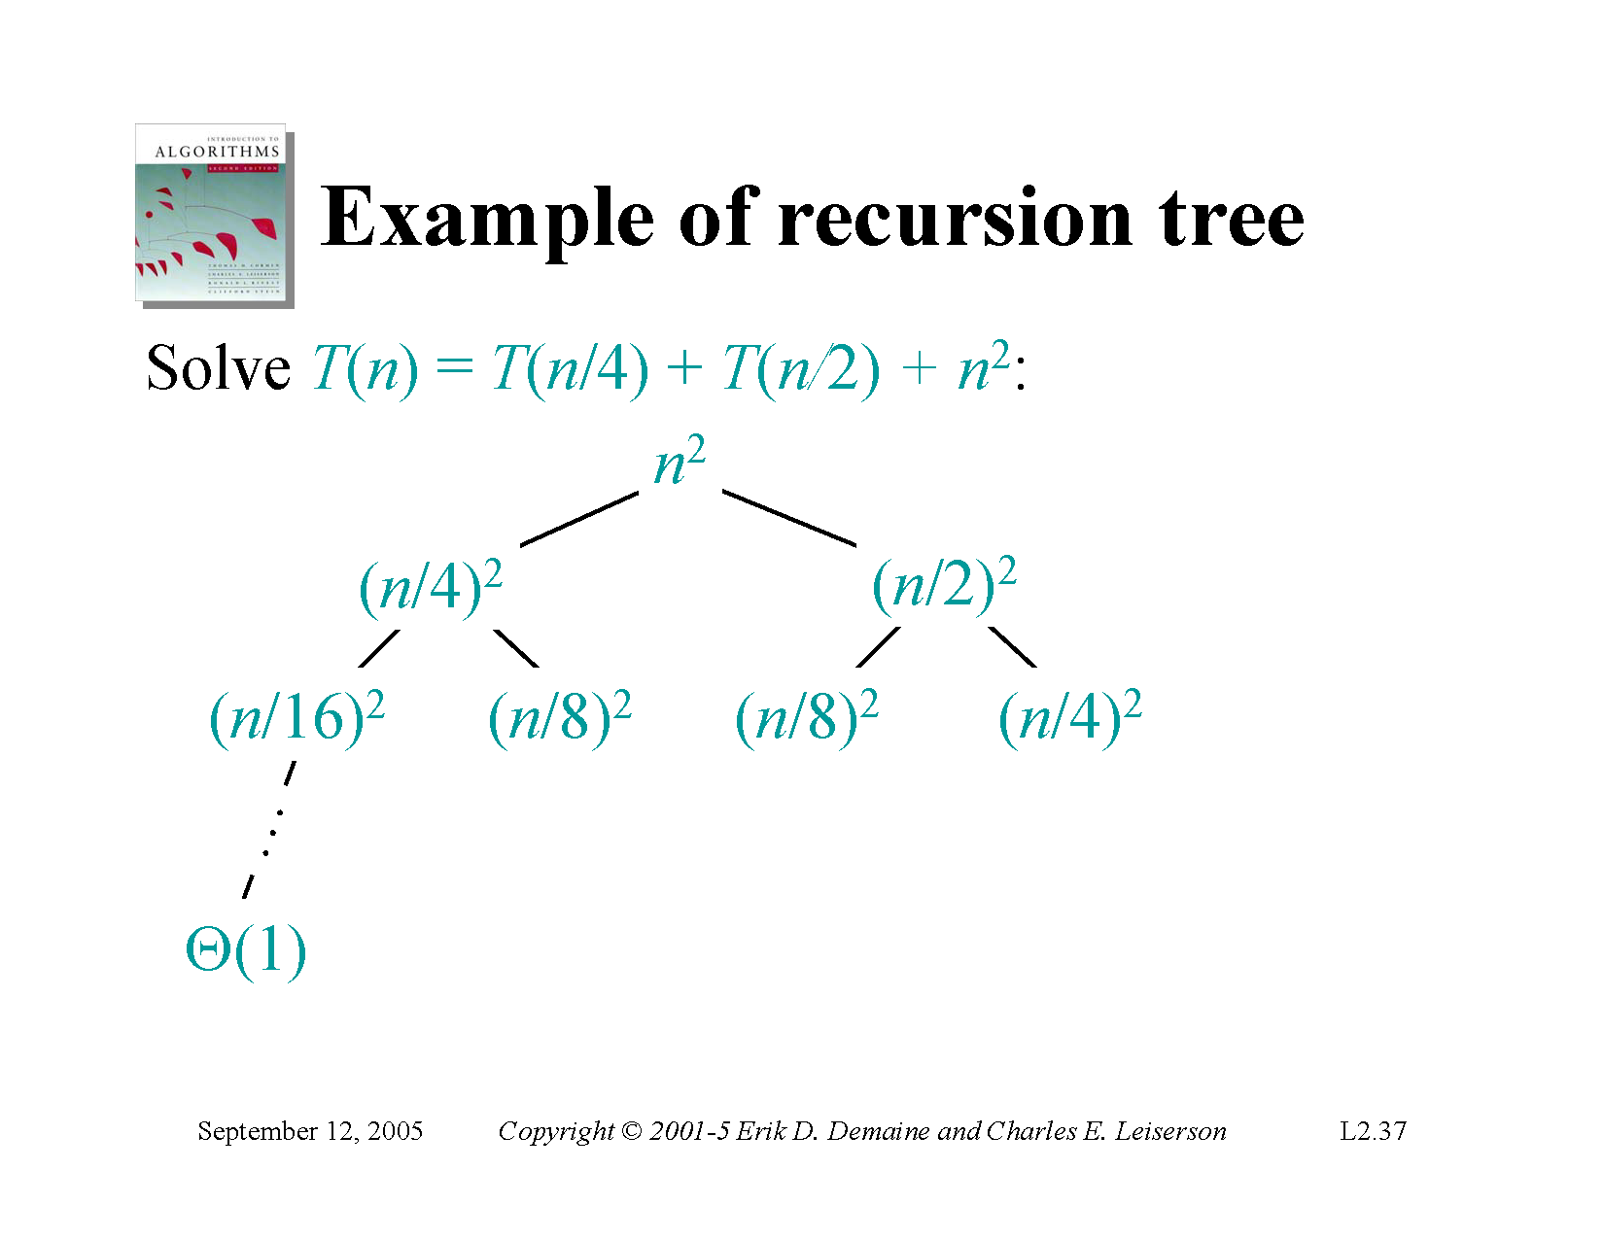

Slide 21


Slide 22
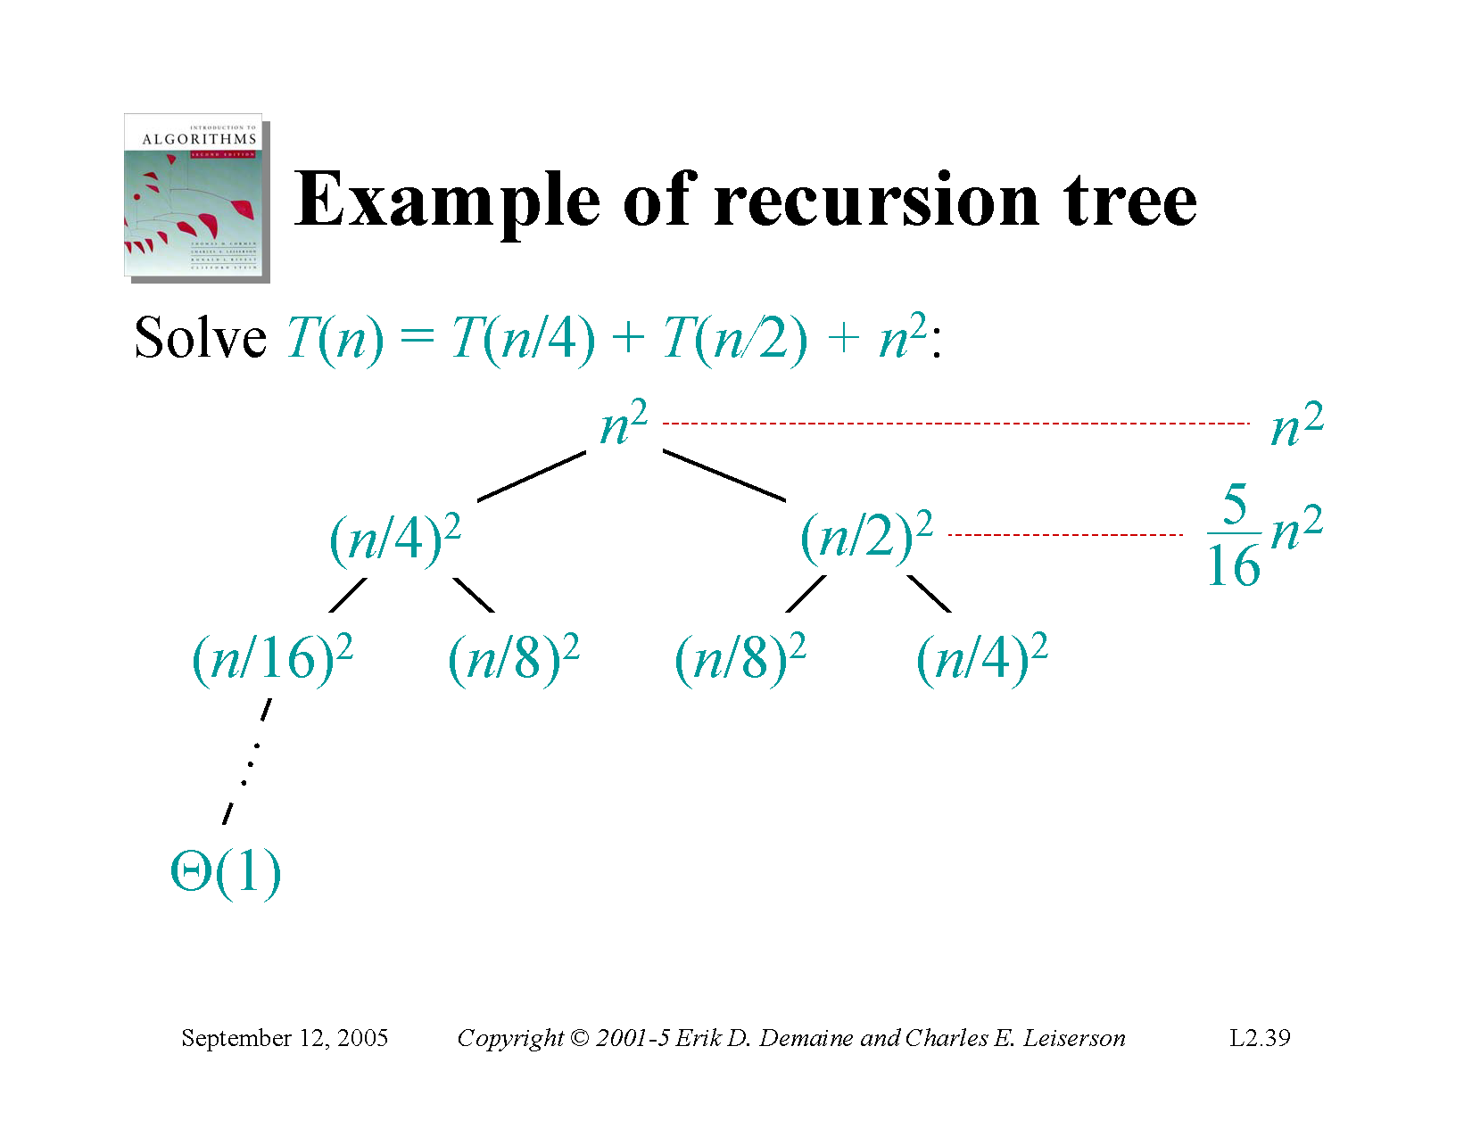

Slide 23
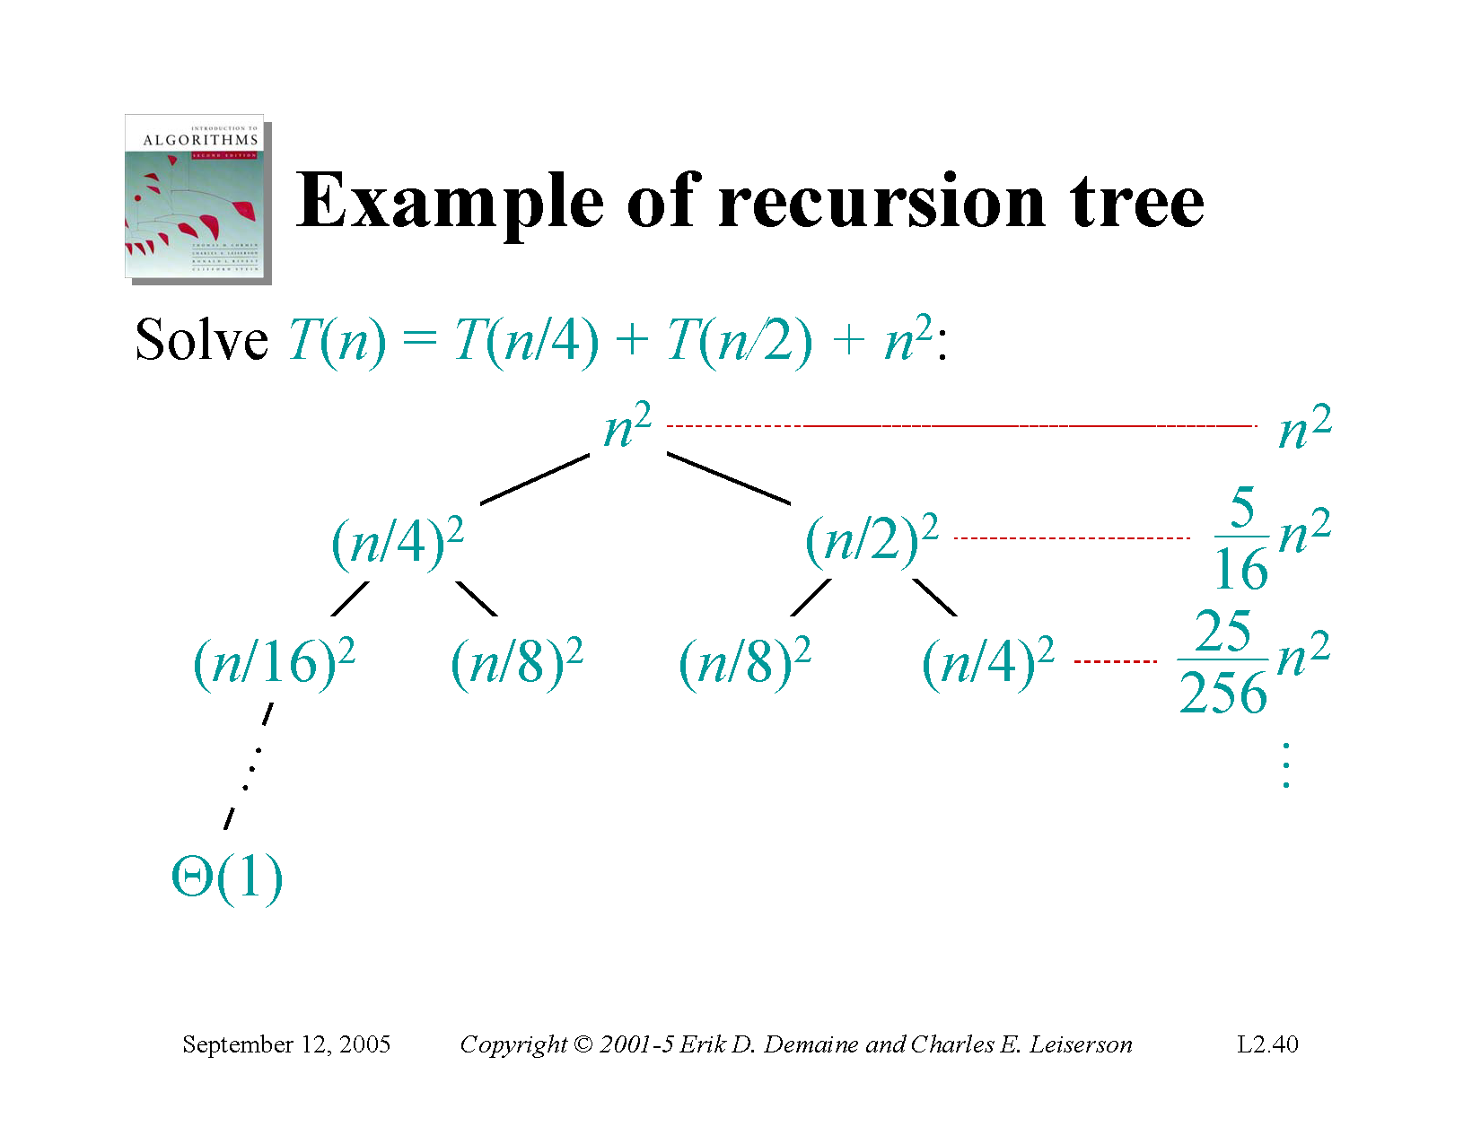

Slide 24
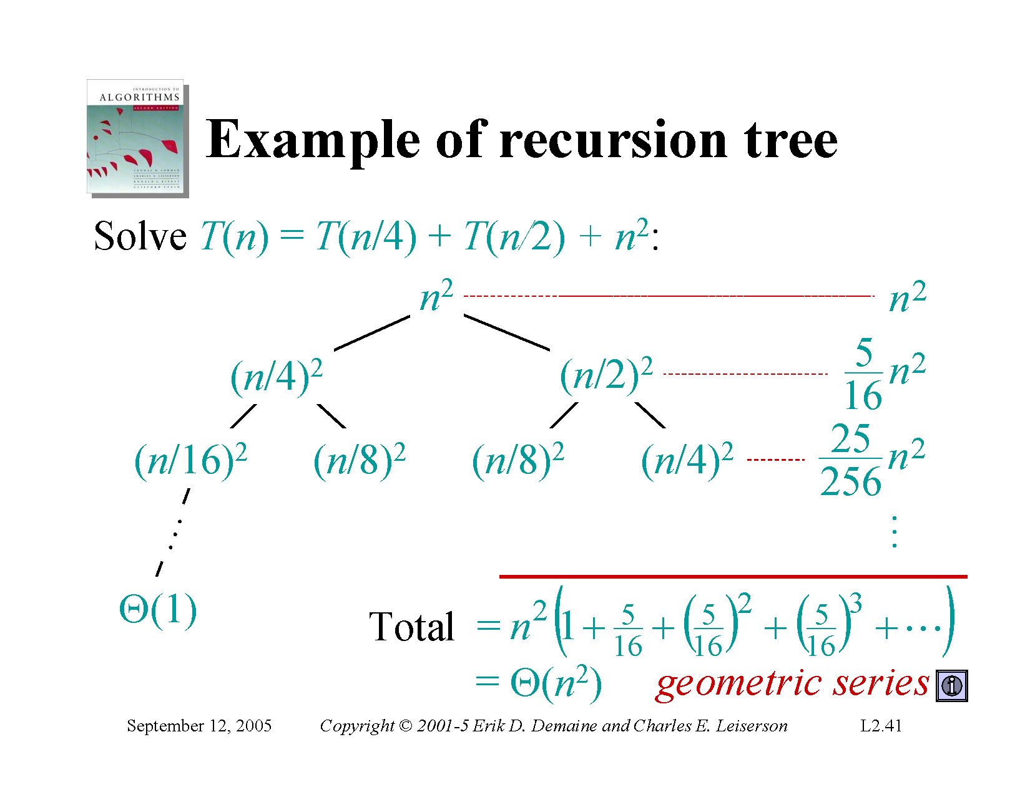

Slide 25
Methods to solve recurrence
Iteration method
Recursion tree method
Master Theorem

Slide 26
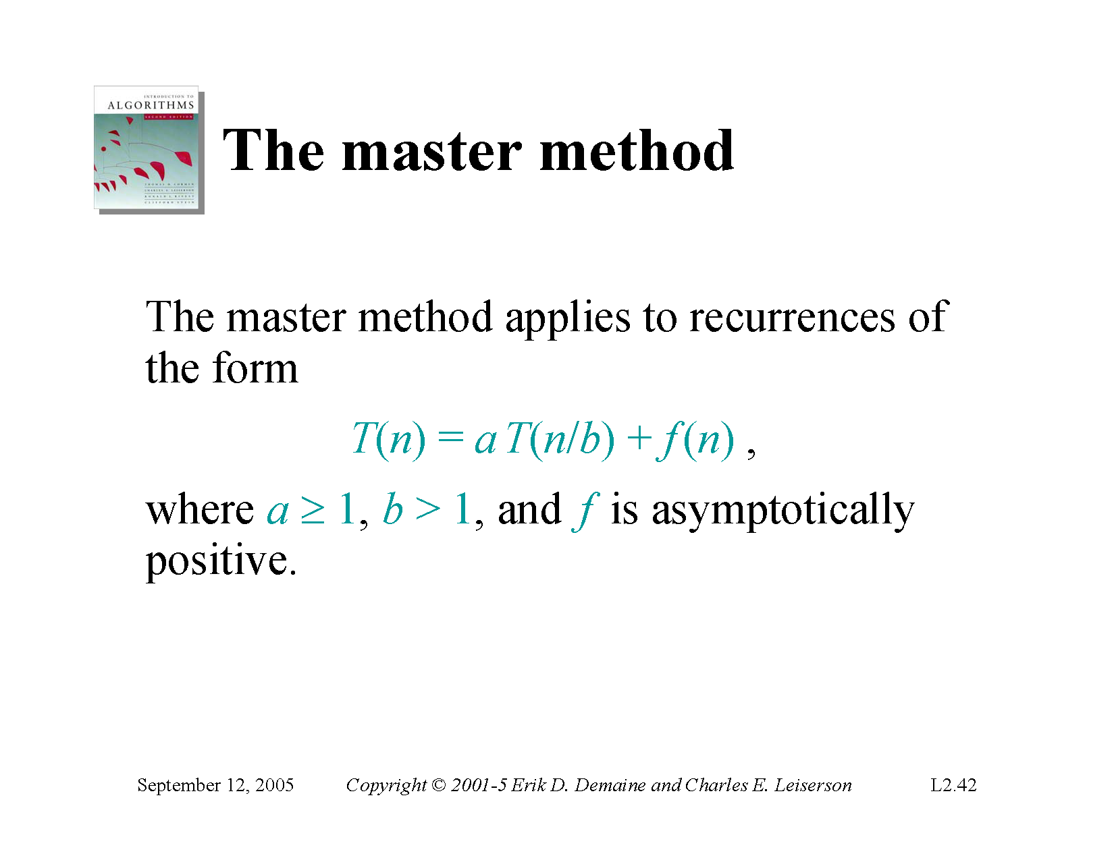

Slide 27
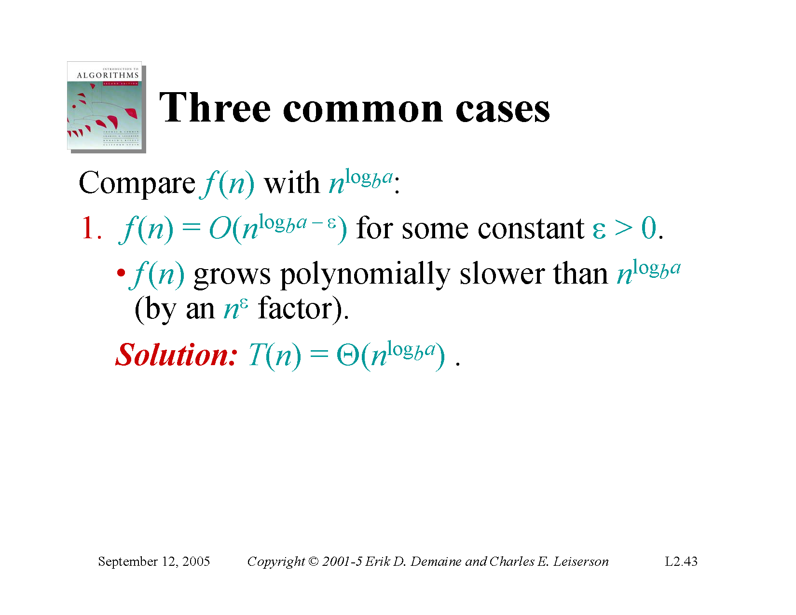

Slide 28
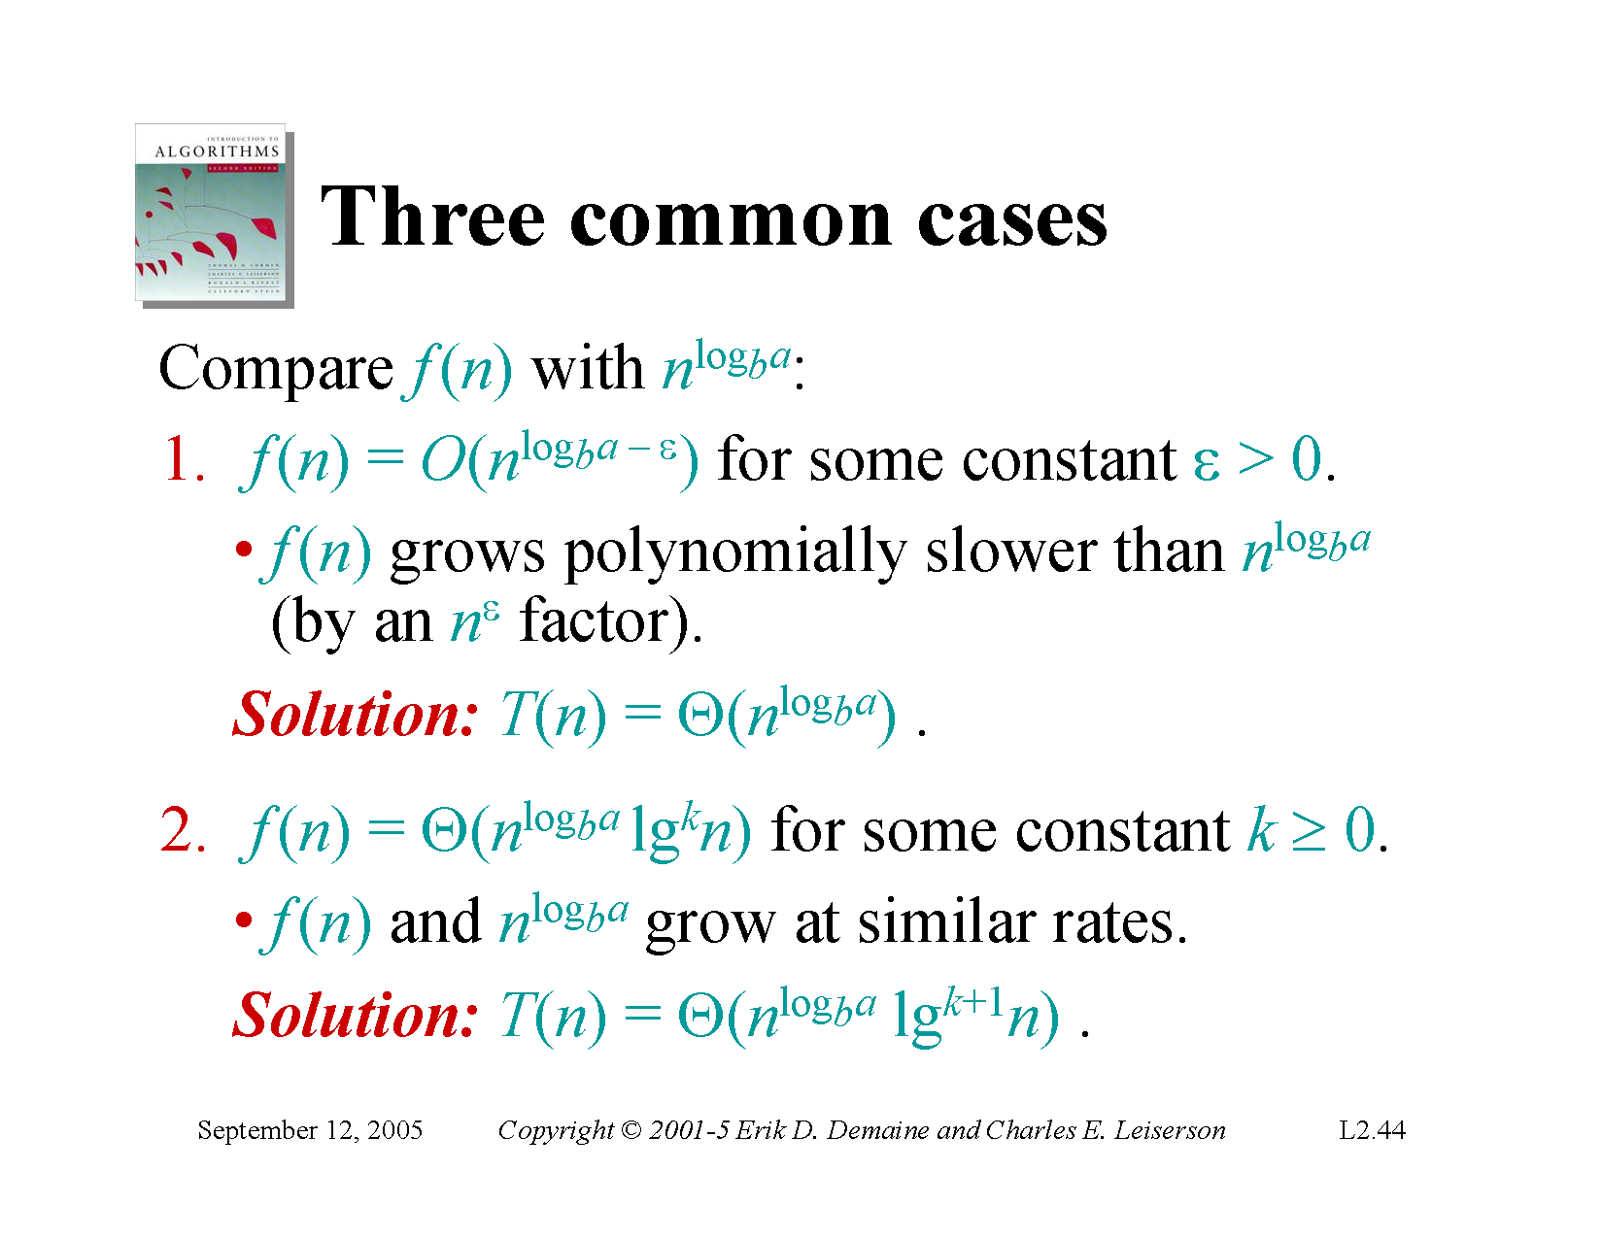

Slide 29
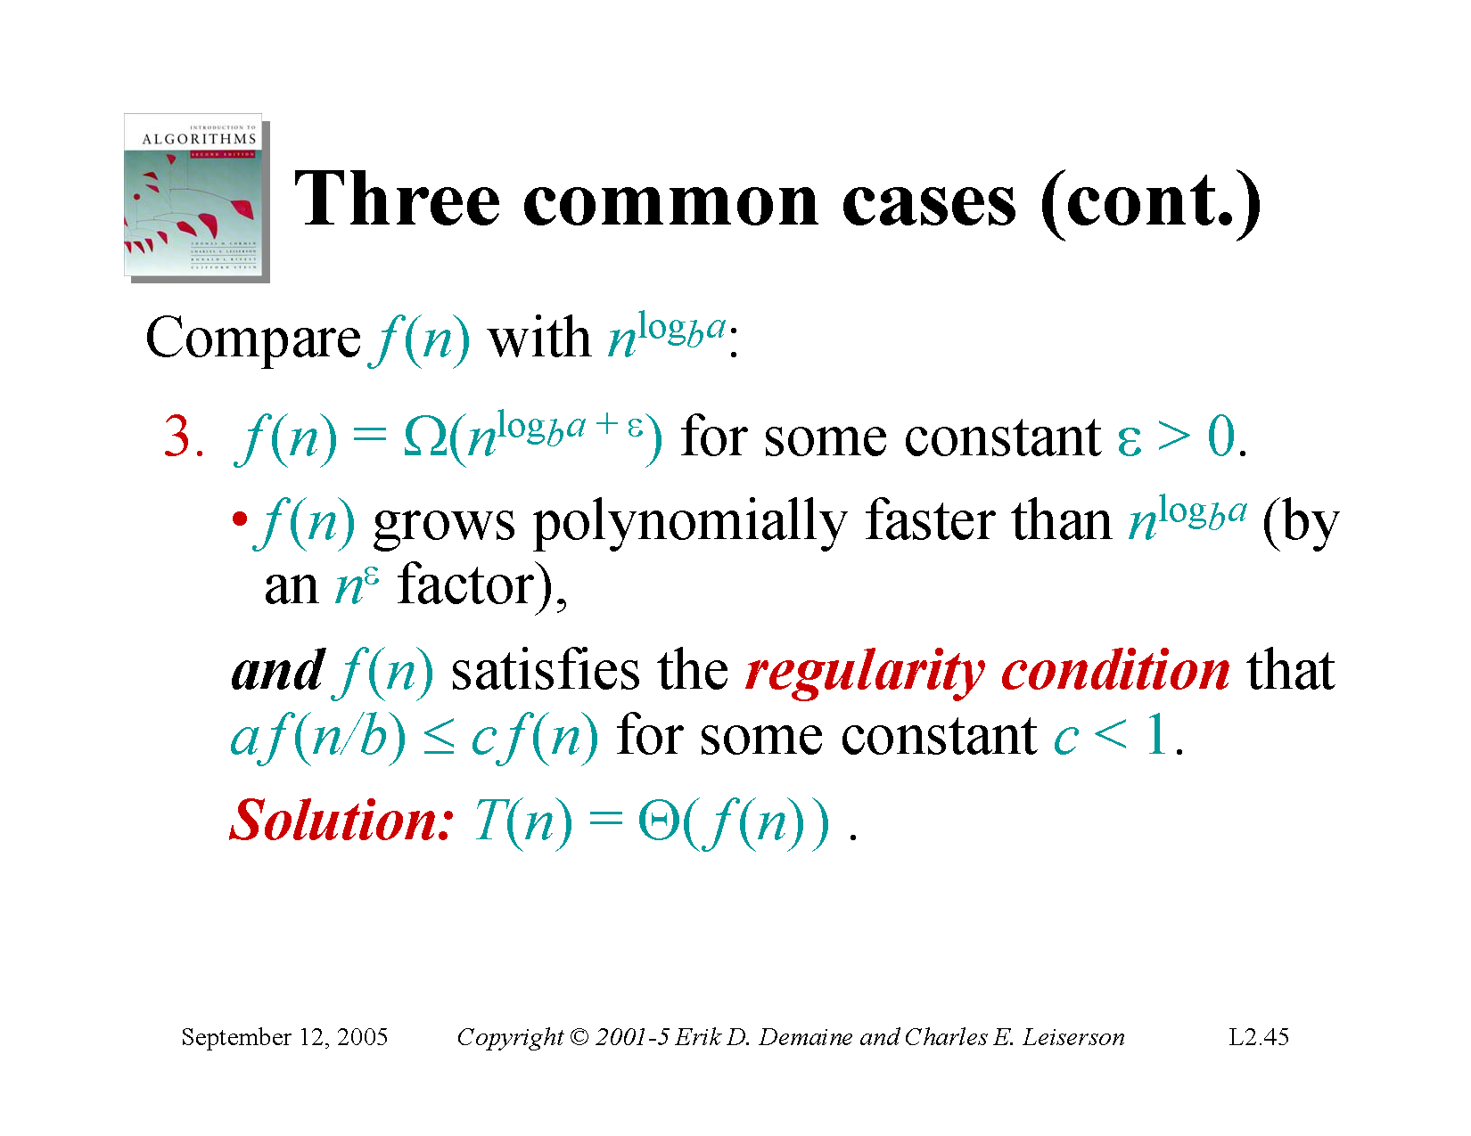

Slide 30
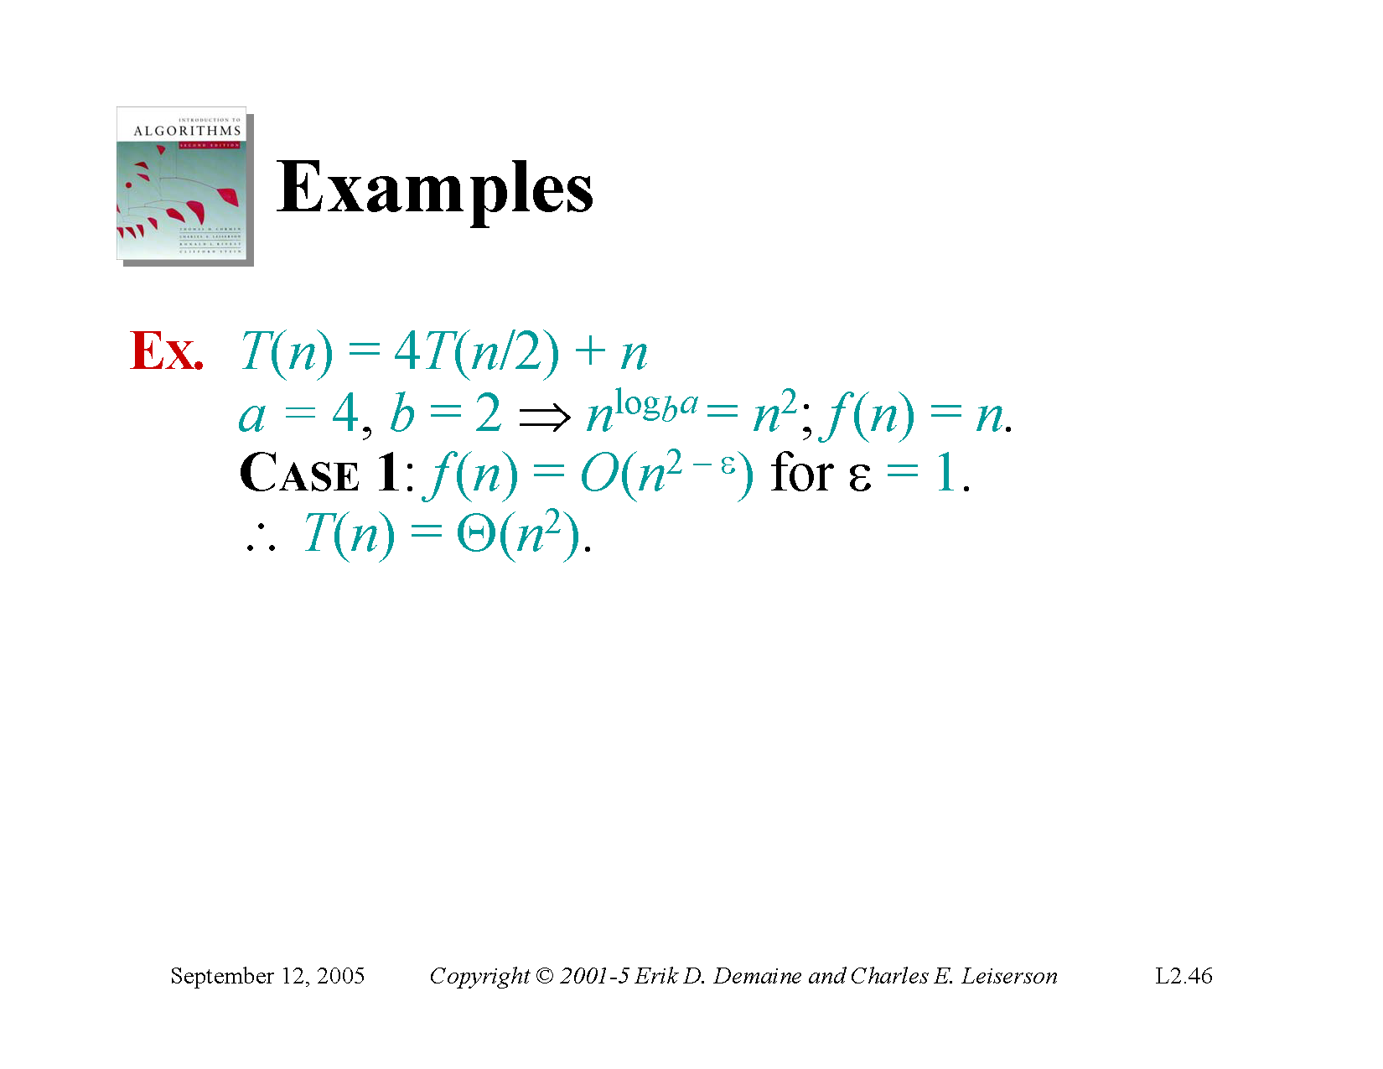

Slide 31
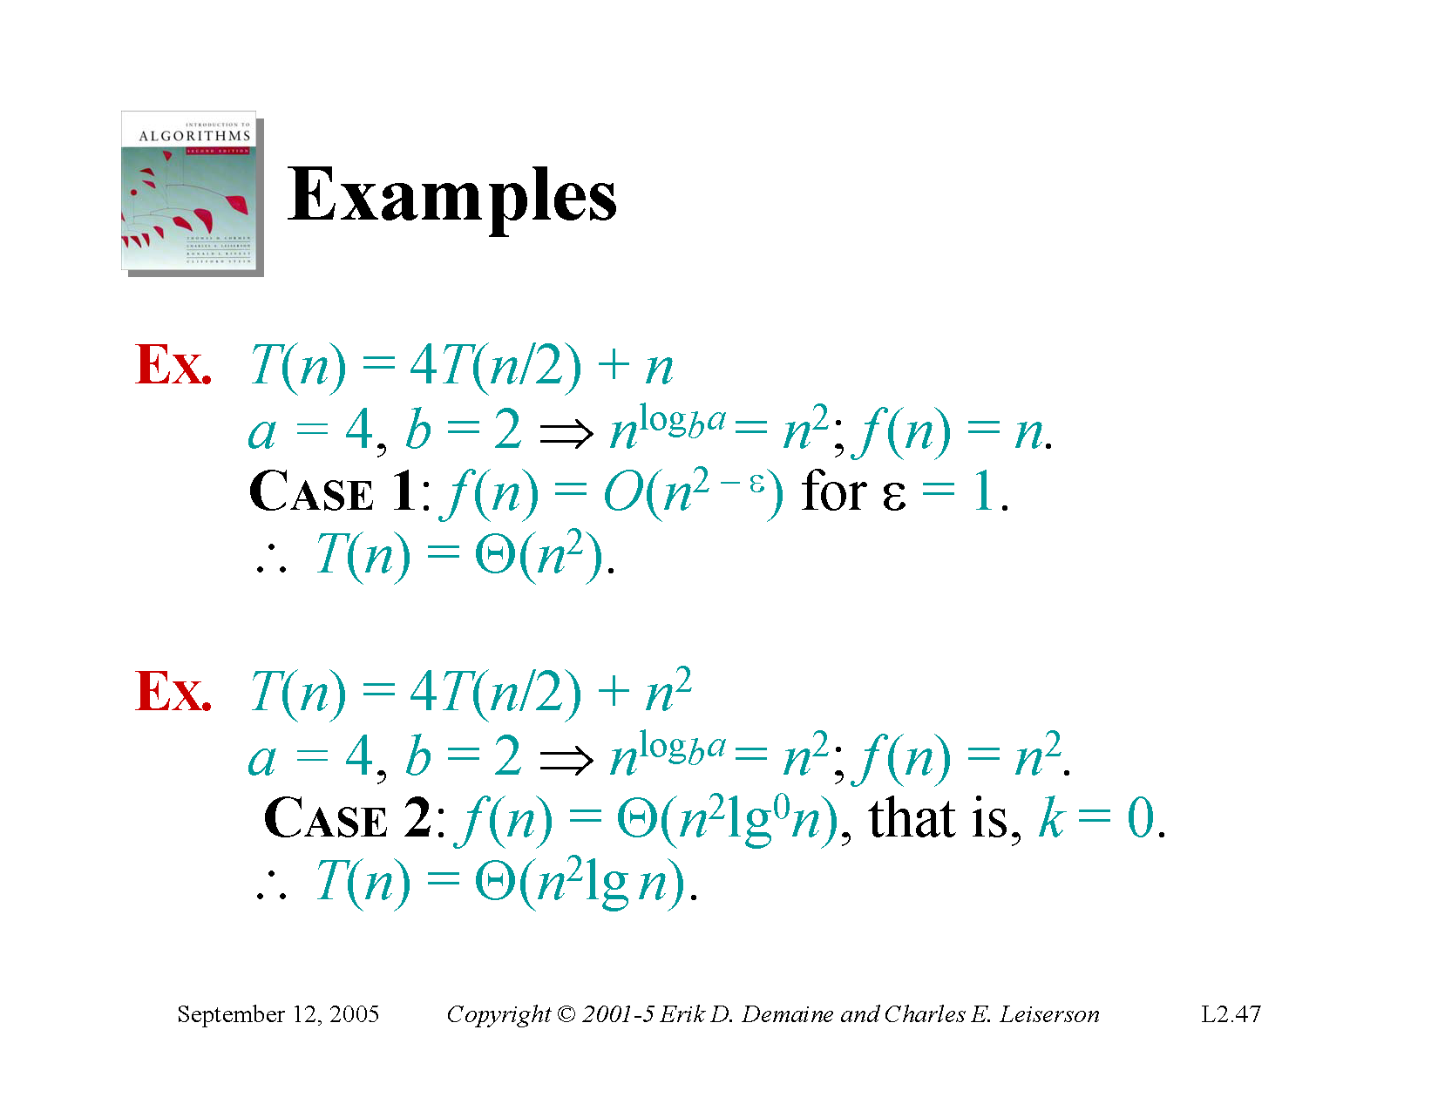

Slide 32
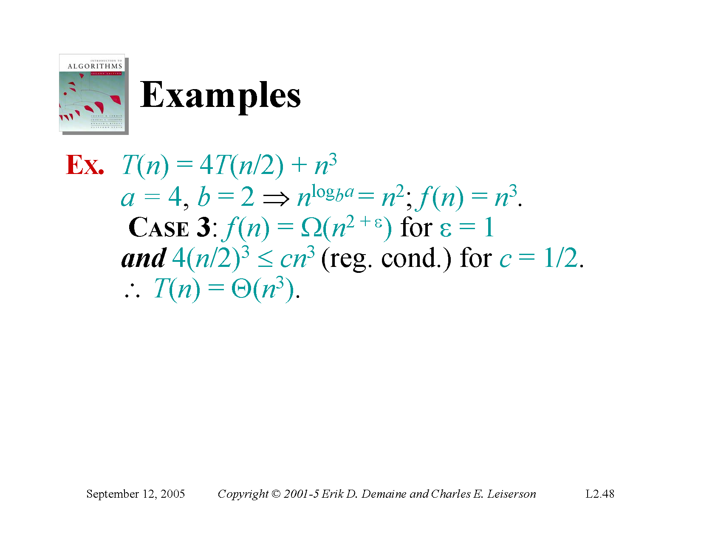

Slide 33
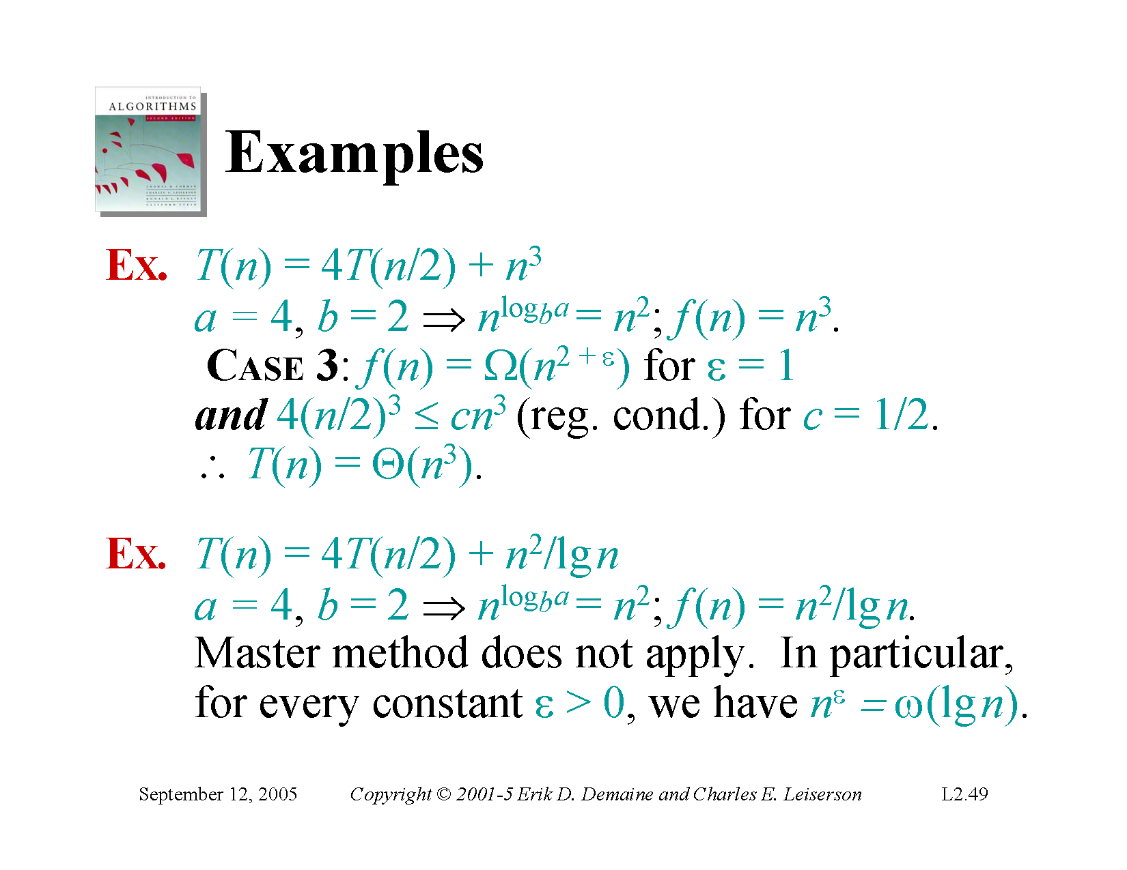

Slide 34
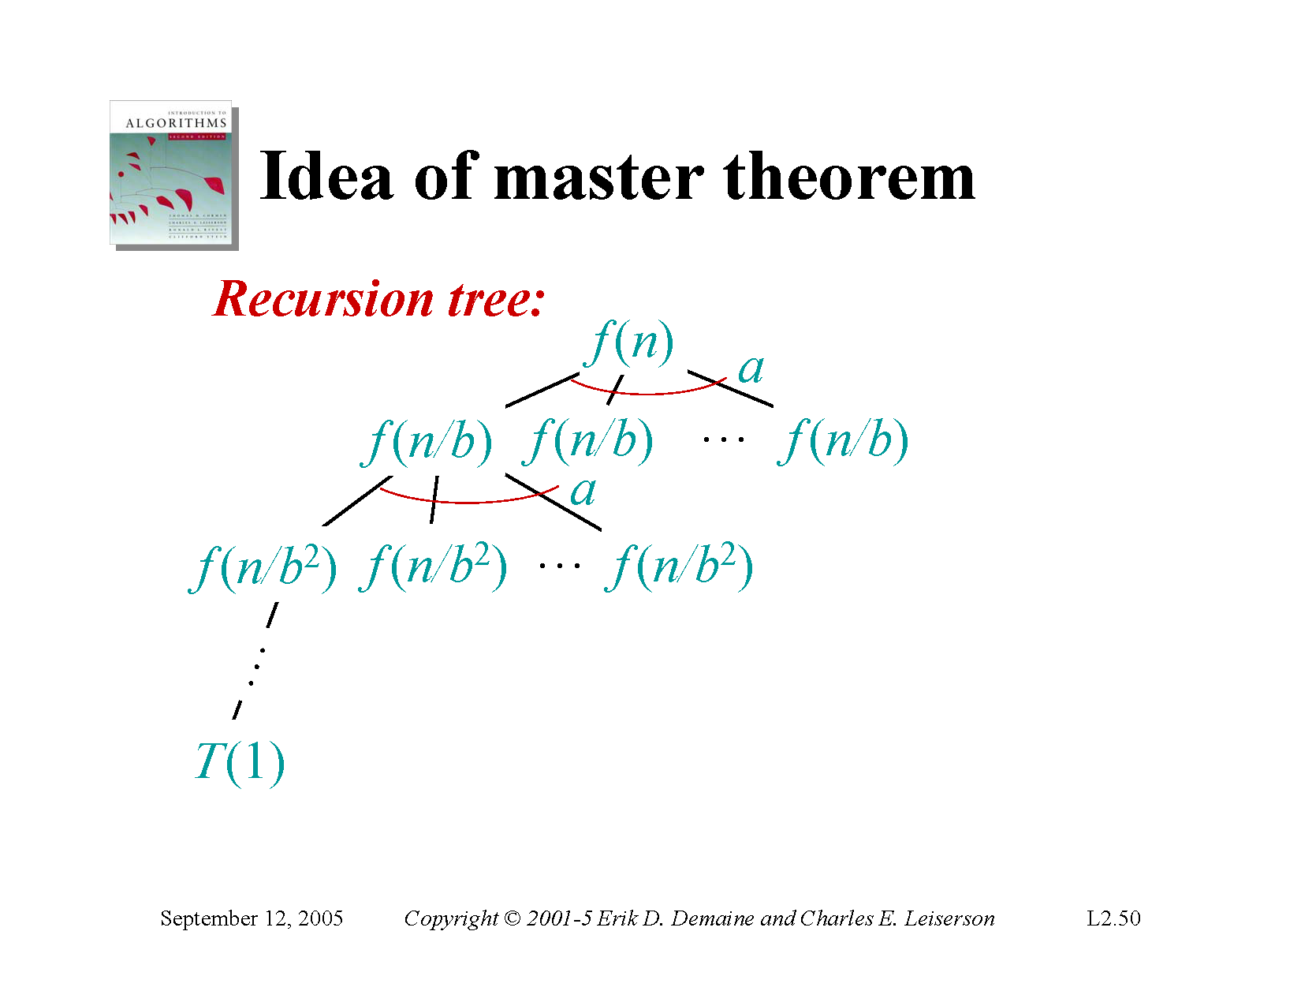

Slide 35
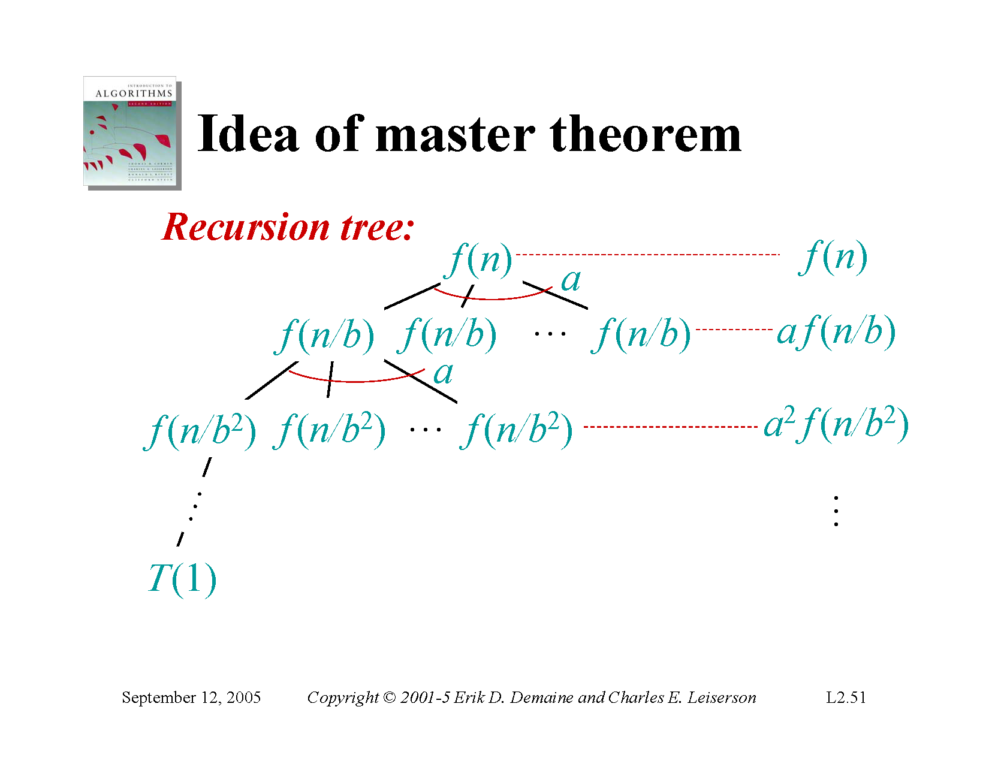

Slide 36
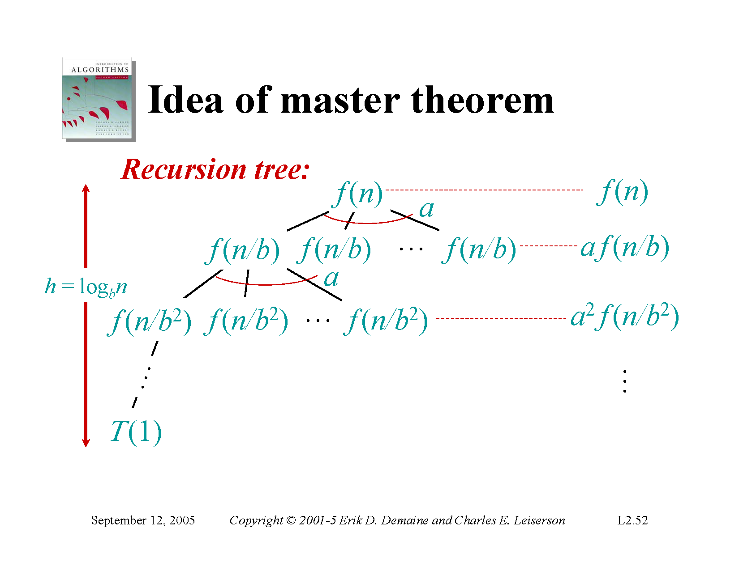

Slide 37
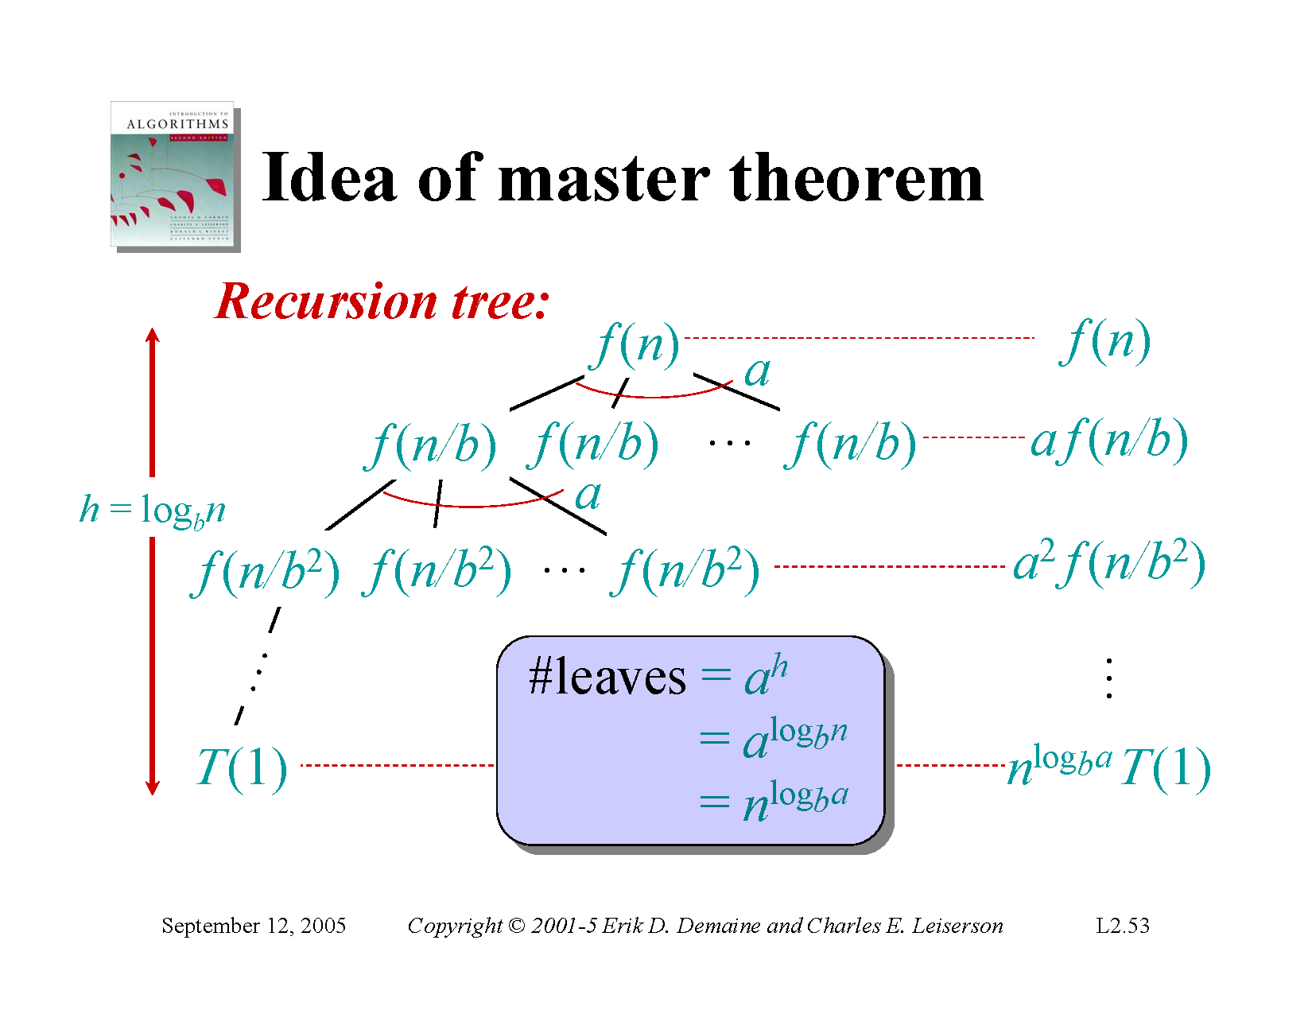

Slide 38
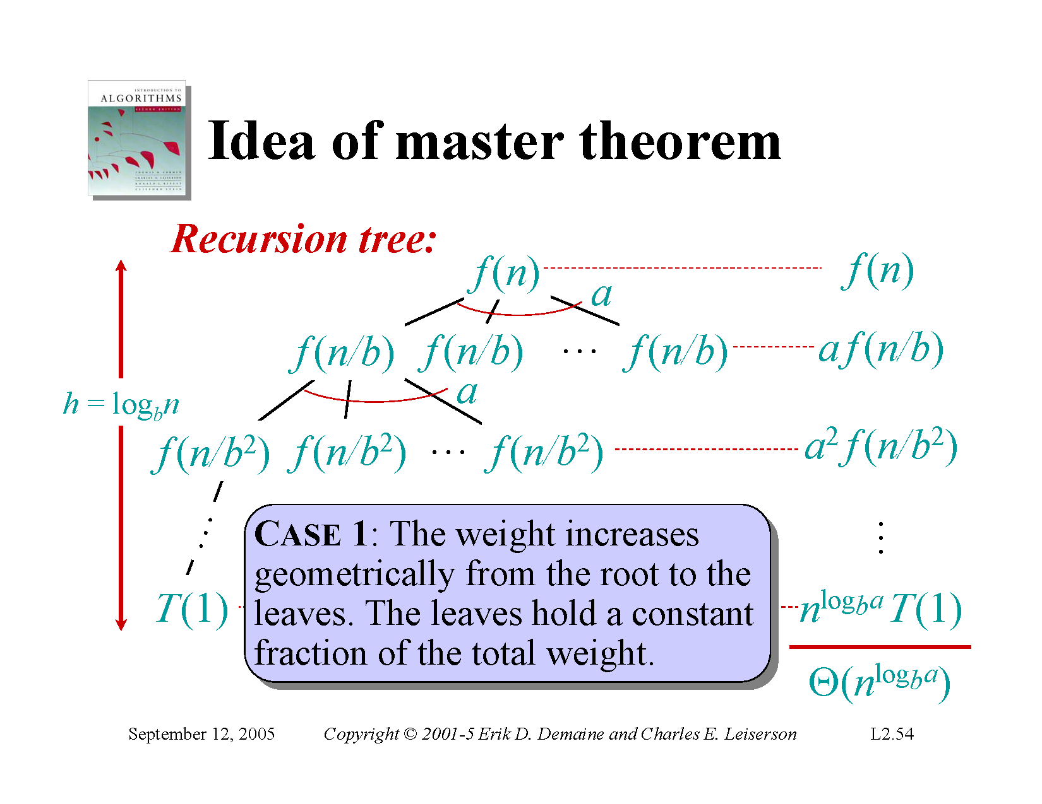

Slide 39
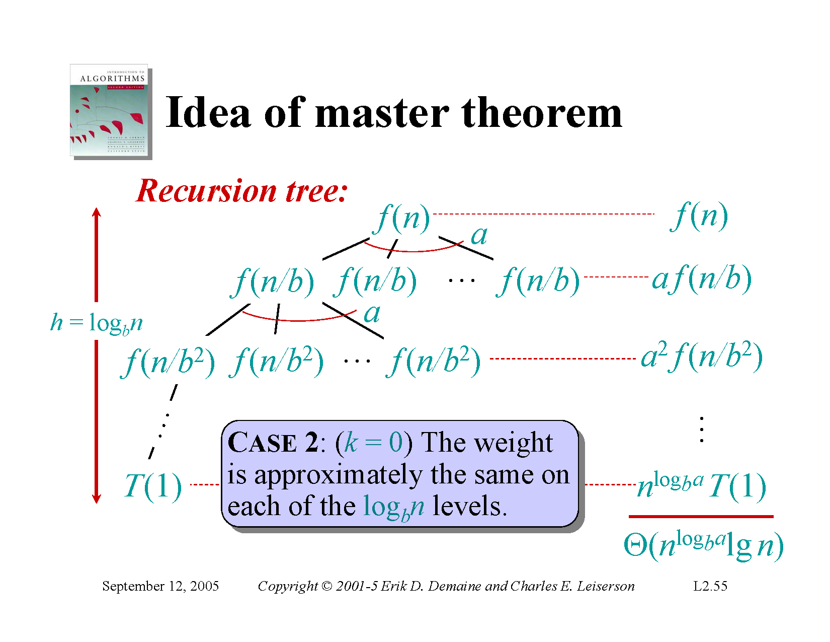

Slide 40


Slide 41
